Slide 1


Data Cleaning with SQL
By Neha Israr

Slide 2
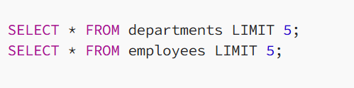
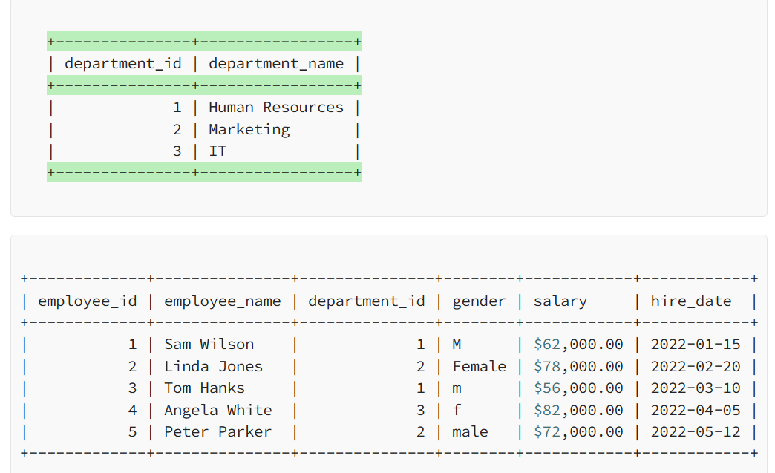
1.1 Retrieve the Data.
Output

Slide 3
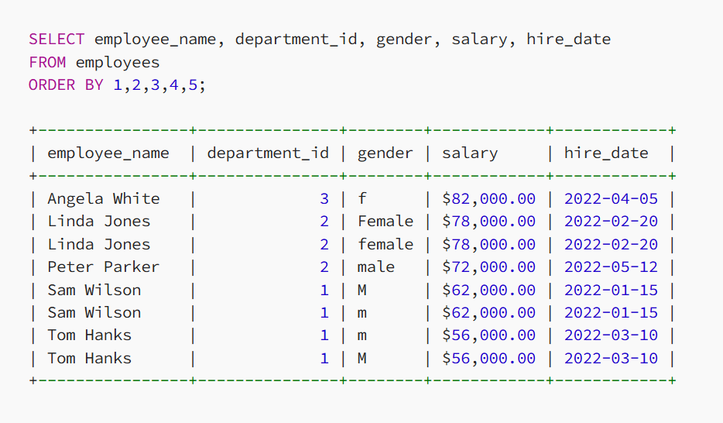
1.2 Retrieve the Data.
Output

Slide 4
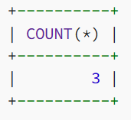
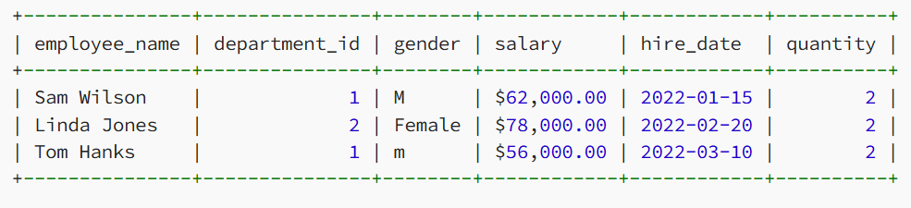
2. Find out Duplicate Count & Values.
SELECT employee_name, department_id, gender, salary, hire_date, COUNT(*) as quantity FROM employees GROUP BY 1,2,3,4,5 HAVING quantity > 1; Output
SELECT employee_name, department_id, gender, salary, hire_date, COUNT(*) as quantity FROM employees GROUP BY 1,2,3,4,5 HAVING quantity > 1;
Output

Slide 5
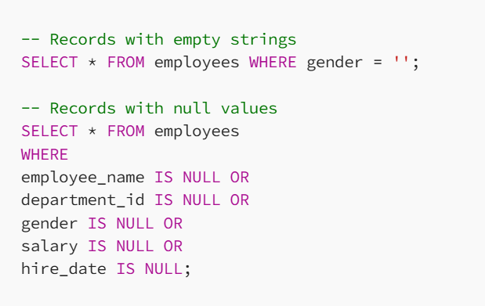
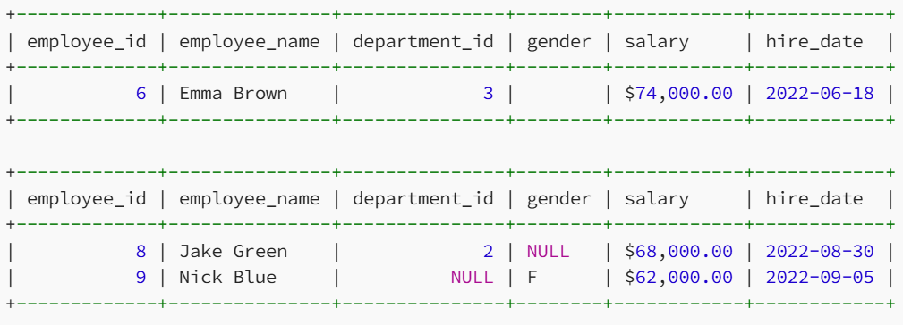
3. Find out Missing Data.
Output

Slide 6
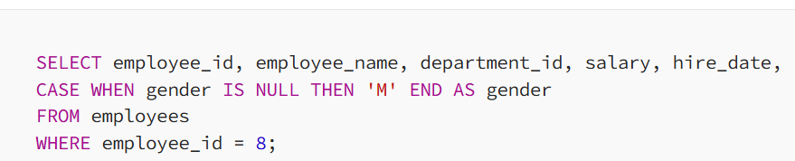
3. Replace Missing Data.

Slide 7
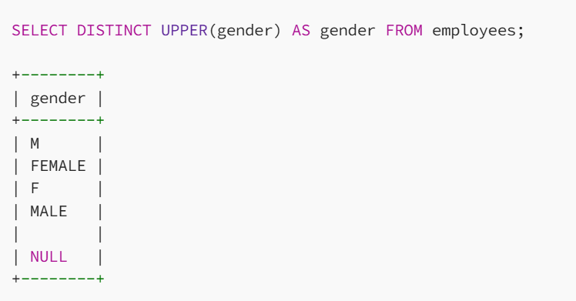
4.1 Correcting Categorical Data.
Output

Slide 8
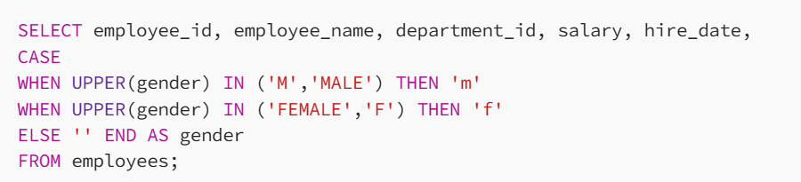
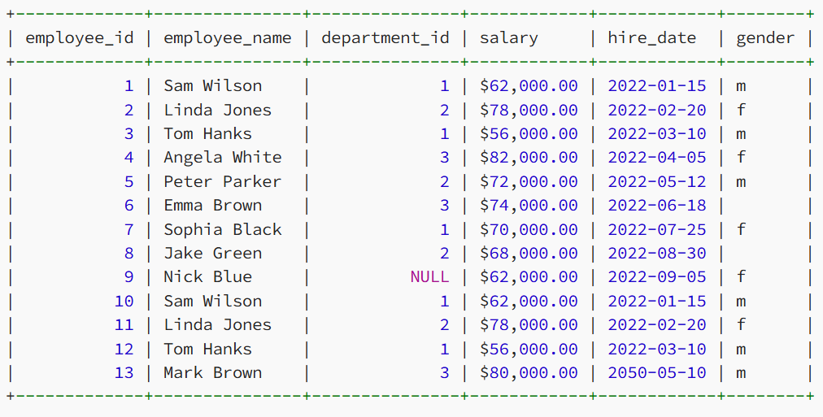
4.2 Correcting Categorical Data
Output

Slide 9
5. Remove Future Dates
DELETE FROM emploees
WHERE hire_date > CURRENT_DATE;
Output
Employee_id | employee_name | department_id | salary | hire_date | gender
1 | Sam Wilson | 1 | $62,000.00 | 1/15/2022 | m
2 | Linda Jones | 2 | $78,000.00 | 2/20/2022 | f
3 | Tom Hanks | 1 | $56,000.00 | 3/10/2022 | m
4 | Angela White | 3 | $82,000.00 | 4/5/2022 | f
5 | Peter Parker | 2 | $72,000.00 | 5/12/2022 | m
6 | Emma Brown | 3 | $74,000.00 | 6/18/2022
7 | Sophia Black | 1 | $70,000.00 | 7/25/2022 | f
8 | Jake Green | 2 | $68,000.00 | 8/30/2022
9 | Nick Blue | NULL | $62,000.00 | 9/5/2022 | f
10 | Sam Wilson | 1 | $62,000.00 | 1/15/2022 | m
11 | Linda Jones | 2 | $78,000.00 | 2/20/2022 | f
12 | Tom Hanks | 1 | $56,000.00 | 3/10/2022 | m

Slide 10
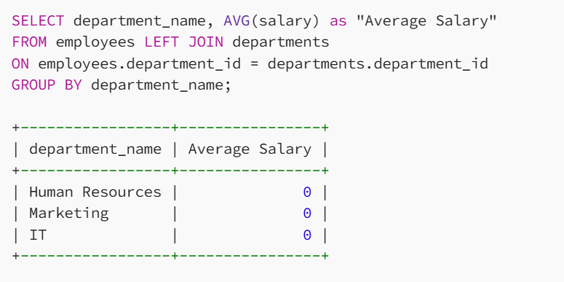
6.1 Type Conversion (Remove dollar sign from Salary Column)
The average salary is zero because of the dollar sign. Let’s fix this.
Output

Slide 11
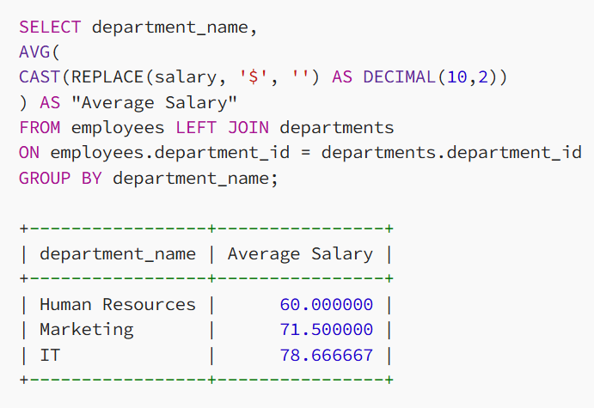
6.2 Type Conversion (Remove dollar sign from Salary Column)
Output

Slide 12

Thank you

